Slide 1
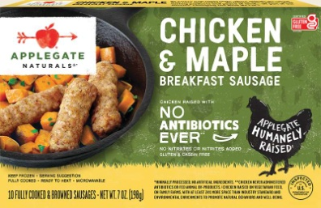
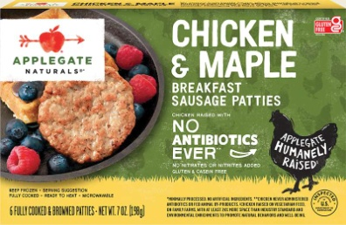
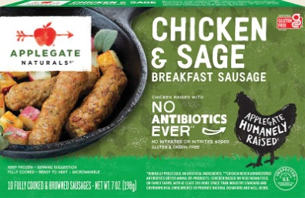
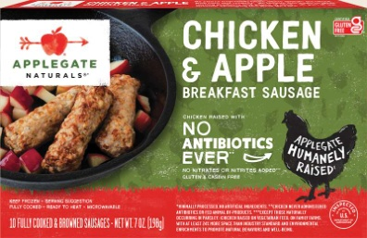
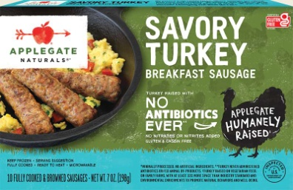
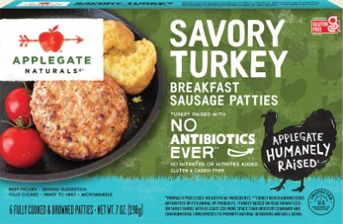
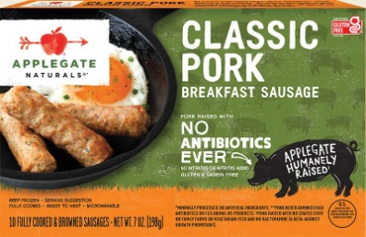
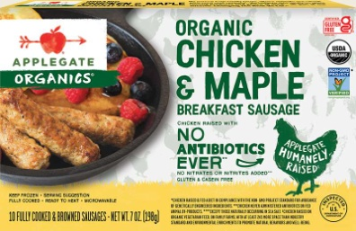
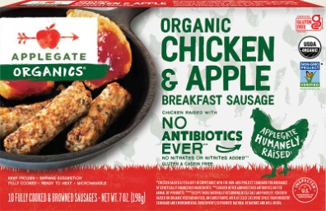
- Frozen Breakfast Sausage -
Chicken & Maple Links
UPC: 25317-00696-5
Pack/Size: 12/7oz
Chicken & Maple Patties
UPC: 25317-00591-3
Pack/Size: 12/7oz
Chicken & Sage Links
UPC: 25317-00697-2
Pack/Size: 12/7oz
Chicken & Apple Links
UPC: 25317-00695-8
Pack/Size: 12/7oz
Turkey Links
UPC: 25317-69400-1
Pack/Size: 12/7oz
Turkey Patties
UPC: 25317-00592-0
Pack/Size: 12/7oz
Classic Pork Links
UPC: 25317-69300-4
Pack/Size: 12/7oz
Org Chicken & Maple Links
UPC: 25317-61600-3
Pack/Size: 12/7oz
Org Chicken & Apple Links
UPC: 25317-61500-6
Pack/Size: 12/7oz

