Slide 1
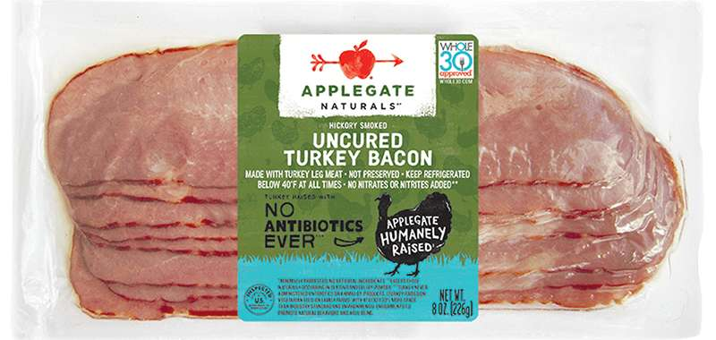
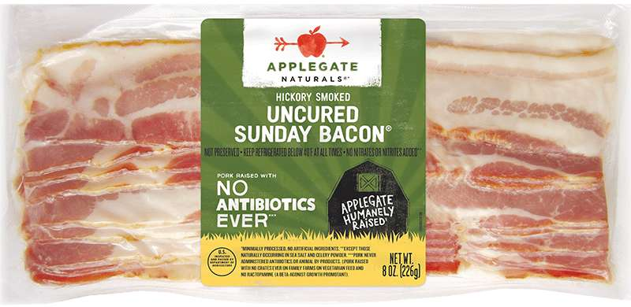
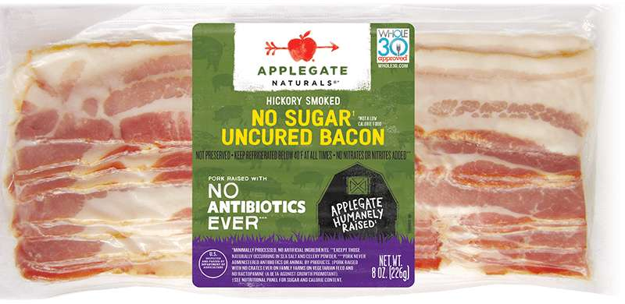
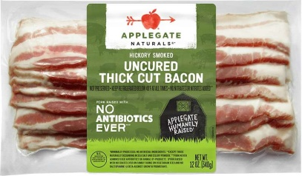
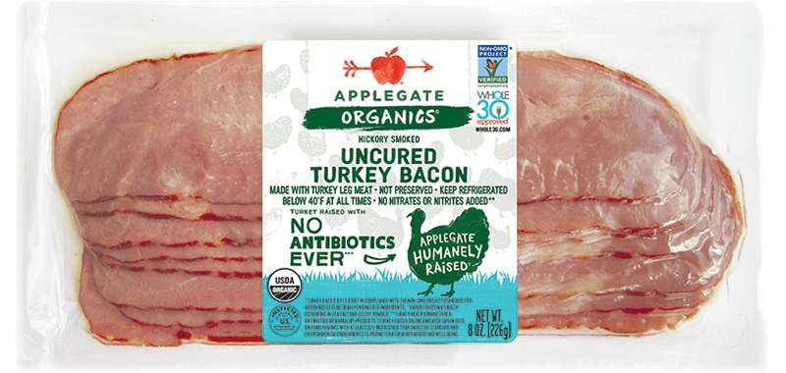
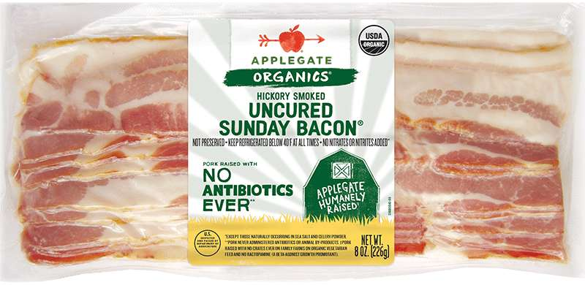
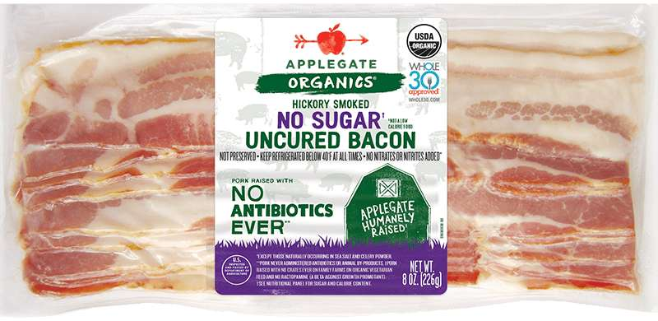
- BACON -
Natural Turkey Bacon
UPC: 25317-12000-5
Pack/Size: 12/8oz
Natural Sunday Bacon
UPC: 25317-10100-4
Pack/Size: 12/8oz
Natural No Sugar Bacon
UPC: 25317-11800-2
Pack/Size: 12/8oz
Natural Thick Bacon
UPC: 25317-11700-5
Pack/Size: 12/12oz
Organic Turkey Bacon
UPC: 25317-12200-9
Pack/Size: 12/8oz
Organic Sunday Bacon
UPC: 25317-10200-1
Pack/Size: 12/8oz
Organic No Sugar Bacon
UPC: 25317-10008-3
Pack/Size: 12/8oz

